Slide 1

Welcome to Investigating with STEM

Slide 2
Welcome!
Anne Zhang
Email: azhang@westorangeschools.org
Phone: (973)-669-5400 x33070
Twitter: @anneducated

Slide 3
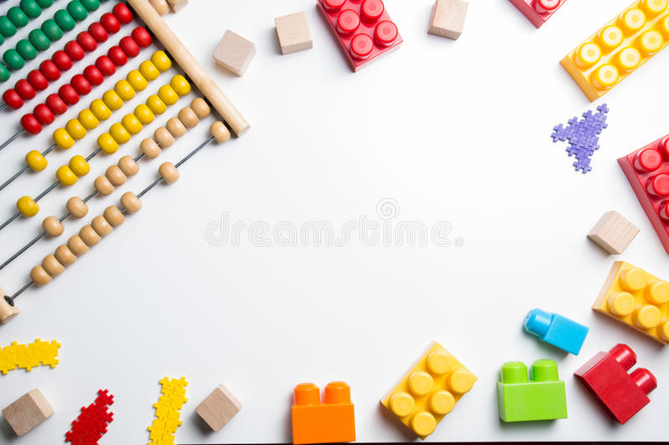
Course Description
This course will build upon the foundational STEM skills and concepts learned in the 6th grade Discovering STEM course. You will learn:
    Social, economic, and environmental impact of technology
    Hands-on project-based learning
    An engineering portfolio” detailing the progress of your projects.
Design, create, and launch a water-powered rocket: design their own original fins
Design and test roller coaster track configurations.

Slide 4
Investigating with STEM Course Goals
Develop analytical and critical thinking skills through hands-on design, open-ended projects and real-world challenges.
Provide differentiated opportunities for all student learning levels and abilities to be successful in the creation of functioning prototypes.
  Roundtable Discussion ‍💻 Group Work ‍💻 Prompts ‍💻Word banks ‍💻 Kahoot ‍💻 G Classroom ‍💻Visualization ‍💻 Graphic Organizers ‍💻 Problem-Based Learning

Slide 5
Investigating with STEM Learning Goals
Design and create a product that addresses a real world problem using a design process under specific constraints.
Identify the design constraints and trade-offs involved in designing a prototype (e.g. how the prototype might fail and how it might be improved) by completing a design problem and reporting results in a multimedia presentation, design portfolio or engineering notebook.
Build a prototype that meets a STEM-based design challenge using science, engineering, and math principles that validate a solution.

Slide 6
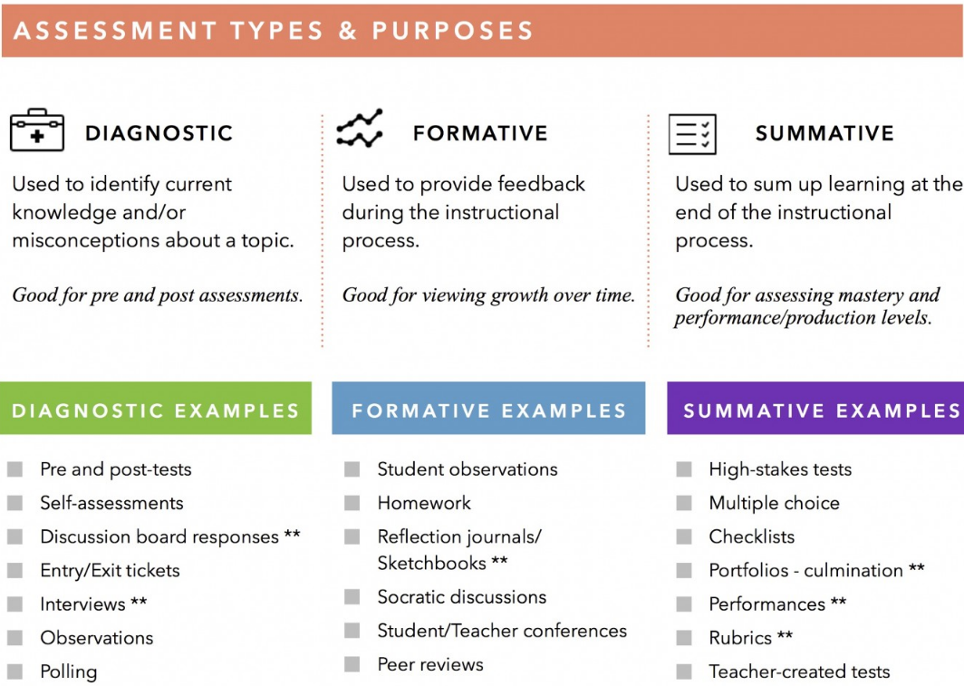
Grading
Understanding and Performance (70%)
  Performance Based Tasks/Assessments/Projects
  Models, Prototypes
Lesson Practice and Activities (30%)
  Guided/Independent Practice
  Check for Understanding
  Classwork Warm-ups, Reviews,
  Sketches, Exit Tickets
  Homework
  Quizzes

Slide 7
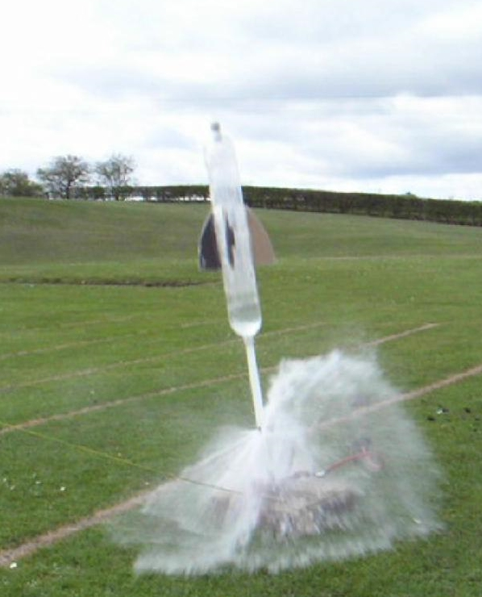
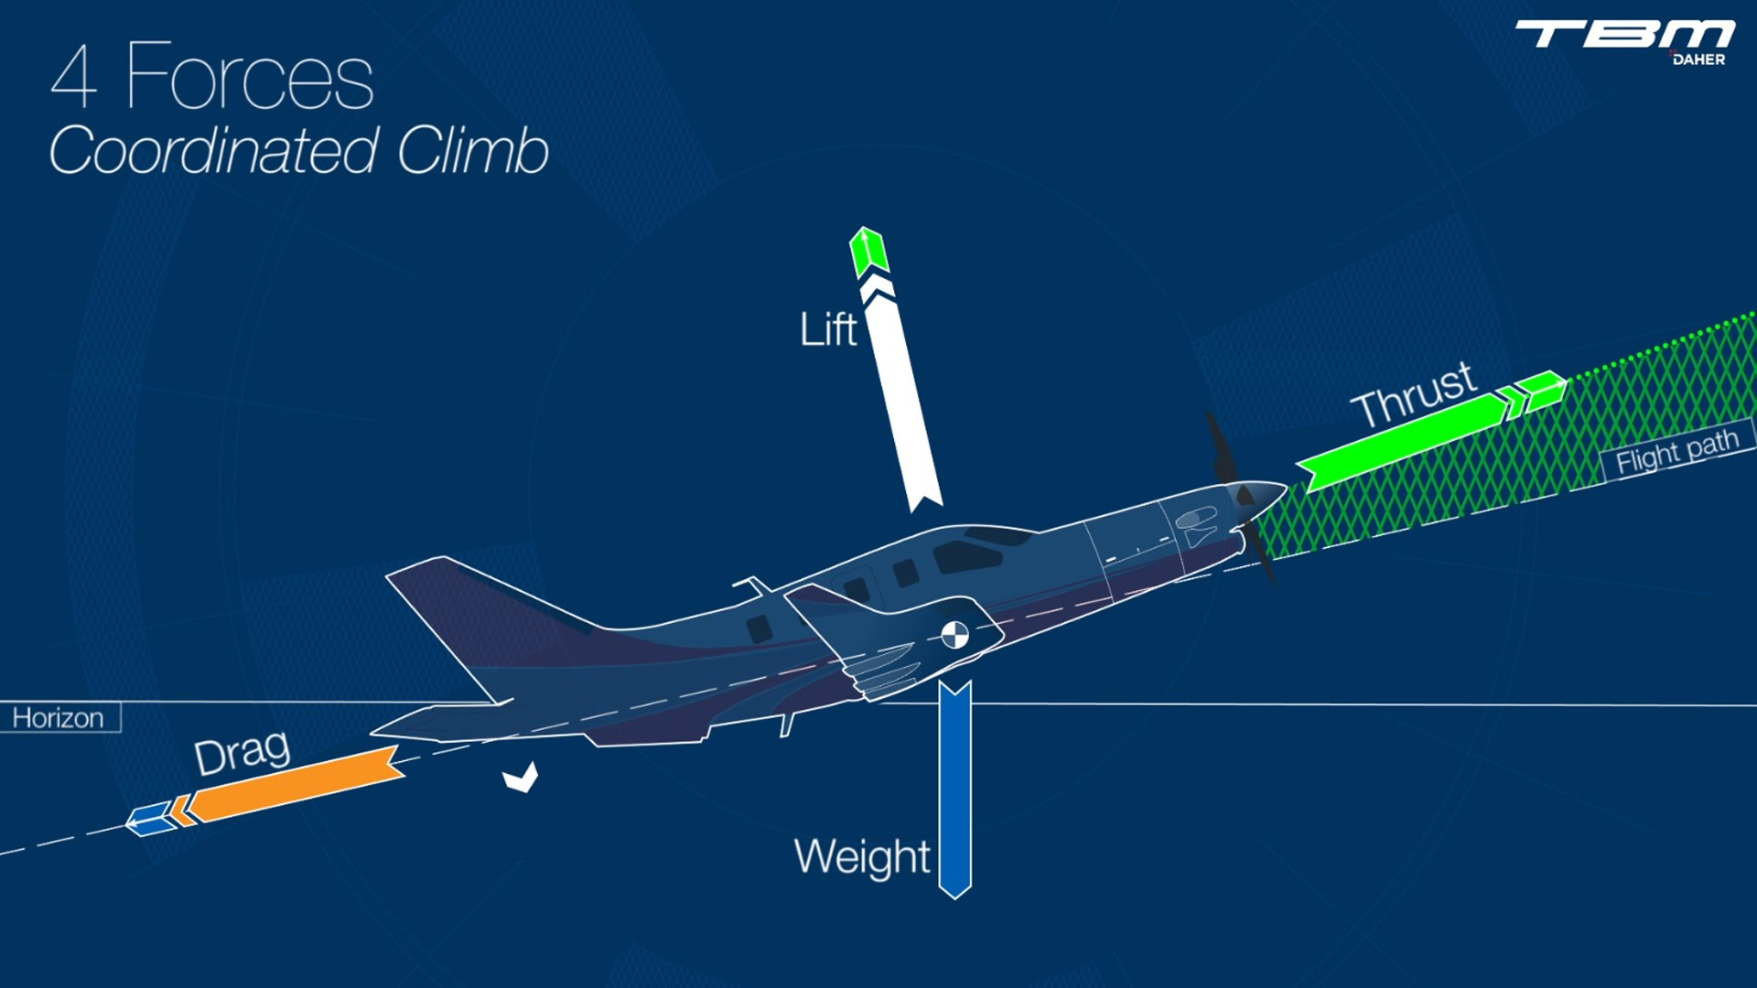
Water Powered Rocket Challenge
Concept: Principles of flight (Demonstrate thrust, lift, gravity by building water-powered rockets)
Students design their own original fins then launch their rocket prototypes outside

Slide 8
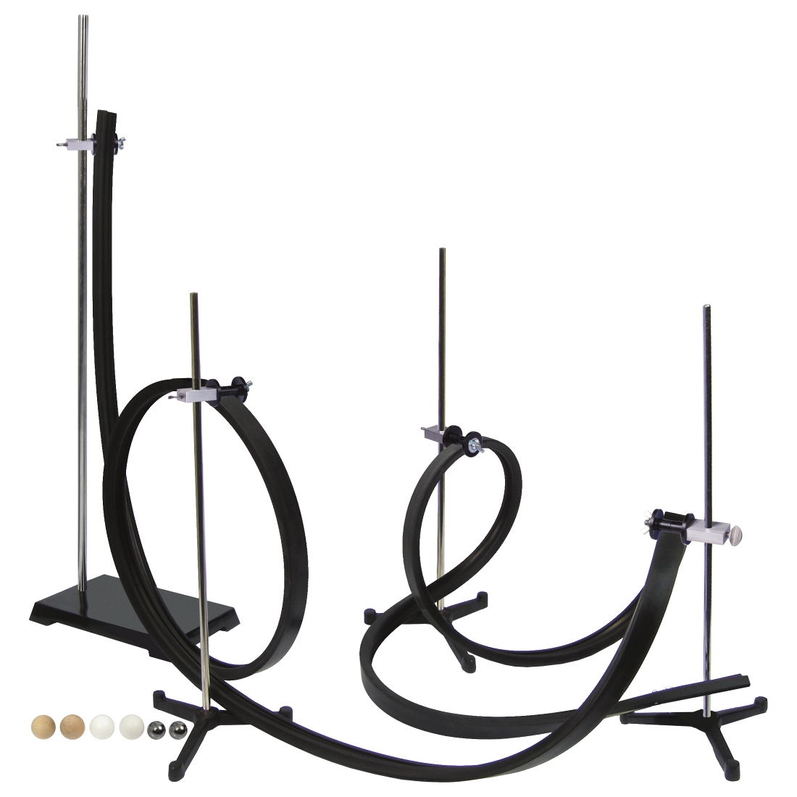
Roller Coaster Challenge
Physics (Demonstrate acceleration, friction, and centripetal force by building roller coasters)
Design and test exciting new roller coaster track configurations

Slide 9
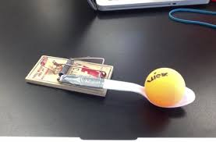
Catapult/Lever Challenge
Levers (Demonstrate mechanical work/advantage, input and output force by building catapults)
Lay siege to a castle with mousetrap catapults with accurate, precisely aimed ammunition.

Slide 10

What is STEM?

Slide 11
8th Grade Course Description
This course will build upon the foundational STEM skills and concepts learned in the 7th grade STEM course. You will learn:
    Principles of design and flight
    Google SketchUp
    TinkerCAD
    Create an engineering portfolio” detailing the progress of your projects.
    Basic robotics through Lego Mindstorms

Slide 12

